Slide 1
Interface
Course Code:
Course Title: Object Oriented Programming -1(JAVA)
Dept. of Computer Science
Faculty of Science and Technology
Lecturer No: |  | Week No: |  | Semester:
Lecturer: | Rifath Mahmud

Slide 2
Lecture Outline
Interface
Attributes of interface
Method of interface

Slide 3
Interface
Interface is just like an Abstract Class but it does not have any regular methods/non-Abstract methods in it.
We can not create any objects of an interface, but we can take object reference.
Interfaces are by default public.

Slide 4
Interface
An interface may have attributes. But these attributes are automatically set to public, static and final all at the same time.
An interface does not have any constructors.
All the methods of an interface are by default public and abstract.

Slide 5
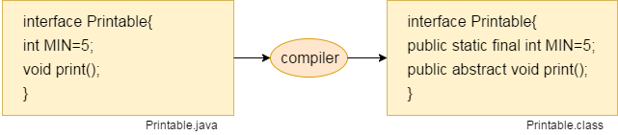
Interface

Slide 6
Interface
As all the methods are by default abstract, they do not have any body/implementations.
However, if we want to give body to any method of an interface, we have to declare the method as static.
The keyword interface is used to denote interface.
public interface IMyInterface {. . . .}

Slide 7
Interface
A Regular/Non-Abstract class can inherit more than one interface.
An abstract class can inherit more than one interface.
An interface can inherit more than one interface.
So, in terms of Interface, Multiple Inheritance is possible.
 | class | interface
class | extends | implements
interface | X | Extends

Slide 8
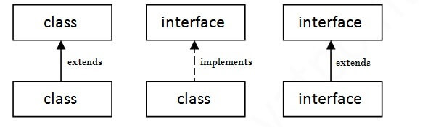
Interface, extends, and implements
All of the followings are possible:
interface IAlpha extends IBravo
interface IAlpha extends IBravo, ICharlie
public class Bravo implements IBravo
public class Bravo implements IBravo, ICharlie
public abstract class Alpha implements IAlpha
So, “class - abstract class - interface” any combination is possible here.

Slide 9
Interface
What is the benefit of using an Interface instead of an Abstract Class?
We can inherit only one abstract class, but we can inherit multiple interfaces.
Interface enables us to achieve another degree of abstraction by guiding a programmer about the methods that must be implemented in a program.

Slide 10
Books
1. Java Complete Reference, 7th Edition, By Herbert Schildt.
2. A Programmer's Guide to Java SE 8 Oracle Certified Associate, Khalid A. MughalRolf W. Rasmussen
3. Java How to Program Java, 9th Edition, By Deitel and Deitel.
4. The Java Language Specification, By J. Gosling, B. Joy, G. Steele, G.Bracha and A. Buckley
5. Introduction to Programming Using Java, 6th Edition, By David j. Eck
6. Head First Java, By Kathy Sierra and Bert Bates

Slide 11
References
1. 1. Java Complete Reference, 7th Edition, By Herbert Schildt.
2. A Programmer's Guide to Java SE 8 Oracle Certified Associate, Khalid A. MughalRolf W. Rasmussen
2. The Java Tutorials. http://docs.oracle.com/javase/tutorial/

